Slide 1

2026 FHLB Program Overview
Notes:
programs.

Slide 2
Agenda
1
FORTIFIED Overview
HAVEN Overview
Pathway Overview
HELP Overview
SNAP Overview
2
3
4
5

Slide 3
FORTIFIED Overview
3

Slide 4

Program Overview
FHLB Dallas supports the replacement of FORTIFIED Roofs through a $10,000,000 allocation to the FORTIFIED Fund
FORTIFIED Standards are resilient building codes developed by the Insurance Institute for Business & Home Safety (IBHS)
Grant amounts (maximum):
  $17,000/household for existing roof replacements
Household requirements:
  Owner-occupied
  At or below 120% of the Area Median Income
  In FHLB Dallas’ District: AR, LA, NM, MS, TX

Slide 5
Program Updates for 2026
Application size: Requests of up to $500,000 for a minimum of 5 up to 50 households per application
Contractors: As of November 1, 2025, IBHS requires contractors be FORTIFIED certified. Evidence of the contractor certification will be required as part of the disbursement request.
Intermediaries: Definition has been updated for 2026.
Household: Rehab of existing roofs only in 2026, amount available per household increased to $17,000.

Slide 6
Intermediaries
Intermediary organizations can assist Members in the sourcing & coordination of applications.
Intermediary means an IRS-established 501(c)(3) nonprofit organization, government entity, or tribal entity that works with a member institution to facilitate grant applications for the Bank’s Homeownership Set-Aside programs and applicable Voluntary programs. The Intermediary must be current on filing and paid all tax obligations to participate in any program.
FHLB Dallas reserves the right to request a copy of the 501c3 letter and/or additional supporting documentation related to the intermediary.
Intermediaries can receive a maximum fee of $1,000/household
  $1,000 counts towards the $17,000/household maximum
*All information required for the application must be verified by the Member Institution. Members are responsible for ensuring intermediaries follow program guidelines*

Slide 7

Offerings & Application Size
Applications will be accepted over two offerings in 2026 with $5 million available per offering:
  January 26
  July 1 through December 31
    Or until funds are exhausted
Application size:
  Up to $500,000 of requested funds
  Minimum of 5, up to maximum of
  50 households

Slide 8
Caps
2026 annual limit per Member: $1,000,000
  If a Member self-facilitates an application with no Intermediary, the Member may only have one “active” application at a time. Each application must be completed with all FORTIFIED Certificates received before submitting a new application.
  If a member is working with multiple Intermediaries, the member may have multiple Intermediary-facilitated applications at the same time.
2026 annual limit per Intermediary: $1,000,000
  Intermediaries may only have one “active” application at a time. Each application must be completed with all FORTIFIED Certificates received before submitting a new application.
  An intermediary may work with multiple members but, may only have one “active” application at a time – an application through one member must be completed with all certificates received before submitting a new application through a different member.
Key Takeaway: The facilitator of the application may only have one active application at a time.

Slide 9
Summary
Offering Dates:
O January 26 until funds are exhausted
O July 1 through December 31 or, until funds are exhausted
O Application windows open at 8:00 AM CT on the first date of the window
O Applications accepted on a first-come-first-serve basis
Double check that amounts are consistent throughout all the documents (including the spreadsheet)
Maximums:
O Member: $1 million per year
O Sponsor: $1 million per year
O $17,000/household for existing roof replacements only
Once the FORTIFIED funds are disbursed, additional costs must be paid from other sources.
Only one active application at a time, per facilitator. If work from one application is not completed no additional requests will be accepted until the application is complete.
Notify FHLB Dallas of any delays or changes associated with the project.

Slide 10
Housing Assistance for Veterans (HAVEN)

Slide 11

Provides owner-occupied housing grants for eligible military families through member financial institutions
U.S. veterans and active-duty, reserve or National Guard service members who have a service-related disability
Gold Star Families who are the immediate family member(s) of a fallen service member
Household income qualification = 165% of Area Median Income (AMI)
HAVEN assisted properties must be a primary residence and located in the District of Arkansas, Louisiana, Mississippi, New Mexico or Texas.

Slide 12

2026 HAVEN Program
Available funding for 2026: $1,000,000
Applications accepted on January 15, 2026 & July 1, 2026, until funds exhausted
First come, first served
Up to $25,000 in HAVEN funds per household can be used for the following purposes:
Necessary home modifications or repairs
  Up to $750 intermediary fee
  Property inspections
Offset construction costs for a newly constructed home

Slide 13

Down Payment and Closing Cost Assistance
Up to $25,000 in HAVEN funds per household may be used for down payment and closing cost assistance to purchase a primary residence
Available only to qualified first-time homebuyers (same definition as HELP)
Homeowner counseling required
No cash back allowed

Slide 14
Pathway Fund

Slide 15

The Pathway Fund
What Is the Pathway Fund?
Formerly known as the Heirs’ Property Program, the Pathway Fund supports efforts to resolve and prevent heirs’ property issues—land passed down without a will, often resulting in clouded titles and legal vulnerability.
Helps to create a clearer path to ownership, stability, and intergenerational wealth.

Slide 16
The Pathway Fund
Heirs' Property refers to land or real estate that is passed down informally—often without a will—resulting in multiple family members holding fractional ownership.
This can create legal and financial complications, such as:
  Difficulty in securing loans or insurance
  Vulnerability to forced sales
  Barriers to home repairs or improvements
  The Pathway Fund supports organizations that work to resolve tangled property titles, as well as support the prevention of these issues in the future.

Slide 17
$3 Million in Funding for Pathway Fund In 2026
Available for FHLB Dallas members to support organizations that address heirs’ property issues.
  Remediation: Grants of up to $150,000 to clear tangled titles and remediate heirs’ property issues
  Prevention: Grants of up to $25,000 for education and prevention through individual training and succession planning
New in 2026: Organizations may receive up to $175,000 if providing both remediation and prevention services.
Member Cap is $700,000
Applications will be accepted August 3 – 21.
Notes:
This is an opportunity for members to partner with organizations in their communities to supply capital that is aimed at providing solutions to heirs’ property. Heirs’ property refers to property inherited without a will or legal documentation of ownership. As property is passed down, each successive generation generally results in more heirs being added to the inheritance. The absence of a deed or will can become more complicated as time passes. If left unresolved, it prevents the ability to sell, collateralize, improve, or otherwise transfer the property. Heirs’ property is a barrier to the accumulation of generational wealth, leads to neighborhood blight, and is a pervasive issue that disproportionately impacts racial and ethnic minority, low-wealth, and distressed urban and rural communities.

Slide 18
Eligible Co-applicants
Organizations must be located in the Dallas District (AR, LA, MS, NM, TX)
Includes non-profits, governmental, and tribal entities
Actively participating in heir’s property remediation or prevention and provide past two years of history
  Cleared titles
  Executed wills/deeds
  Property financial literacy training/succession planning
Spend the funds within one year

Slide 19
HELP Overview

Slide 20
2026 Program Specifics
Provides down payment & closing cost assistance for qualified, first-time homebuyers on a first-come, first-served basis. All U.S. property locations are eligible.
Program Allocations:
2026 Allocation: $17 Million available until exhausted or December 31, 2026
2026 Allocation Offerings
20% of the allocation available per offering:
January 2nd
April 6th
May 4th
June 15th
September 7th
Individual Caps:
$20,000 per household - AR, LA, MS and outside FHLB Dallas District
$25,000 per household - NM and Texas
Member Caps:
Member Cap: $150,000 per offering
Annual out of district cap: $375,000
New in 2026: First Mortgage must be originated by member institution, wholly-owned subsidiary of member, or 501c3 Non-profit organization (Habitat, etc.).
Notes:
The Member cap will be 150K per offering and it will not roll over into subsequent offerings.
Funding will be available on a first-come, first-served basis at the beginning of each allocation offering,.

Slide 21
Borrower Eligibility Requirements:
First-Time Homebuyer*
Household gross Income is below 80% Area Median Income
At Least $500 Homebuyer Contribution
Completed Homebuyer Counseling Course
Applies to and must be signed by all borrowers listed on closing disclosure*
Homebuyers $500 Contribution must come from borrowers' own funds.
Homebuyer is not allowed to receive “cash back” at closing.
HELP Funds cannot be used to paydown any form of existing debts.
Notes:
Asterisk placed *- first time homebuyer attestation

Slide 22
SNAP Overview

Slide 23


2026 Program Specifics
SNAP provides subsidies for the repair and rehabilitation of owner-occupied housing of eligible, special-needs households at or below 80% AMI
Program Allocations:
2026 Allocation:
$1.8 Million
2026 Rounds:
March 4-5
July 15-16
Each Homeowner can receive up to $10,000
Each member can submit a maximum of
6 Applications for 2026
Each member can submit a maximum of $20,000/Offering
Each intermediary can submit a maximum of $40,000/Offering
*Applications can be submitted from 8am CST on the first day of the offering until 5pm CST on the final day of the offering

Slide 24
SNAP Specifics
At least one Permanent occupant of the household must meet at least one of the special needs criteria.
Eligibility Criteria:
  Income at or below 80% AMI
  Special needs: households with elderly (55+), persons with disabilities, persons recovering from physical abuse, alcohol, or drug abuse, or persons with HIV/AIDS
  Owner-occupied primary residence
  In FHLB Dallas’s district: AR, LA, MS, NM, TX
All submissions must be submitted by member financial institutions via GrantConnect

Slide 25
Developer & Inspection Fees
New definition in 2026: Intermediary means an IRS established 501c3 nonprofit organization, government entity or tribal entity that works with a member institution to facilitate applications for the Bank’s Homeownership Set-Aside programs and applicable Voluntary programs. The Intermediary must be current on filing and paid all tax obligations to participate in any program.
Developer Fee:
Intermediaries can take a developer fee up to $750/request
Intermediaries serving as the project contractor cannot take a developer fee*
Member institutions cannot take developer fees*
Inspections:
SNAP funds can cover pre- and post-inspection costs
The 3rd party inspector must be selected by the Member
Contractor invoice required after work is completed

Slide 26
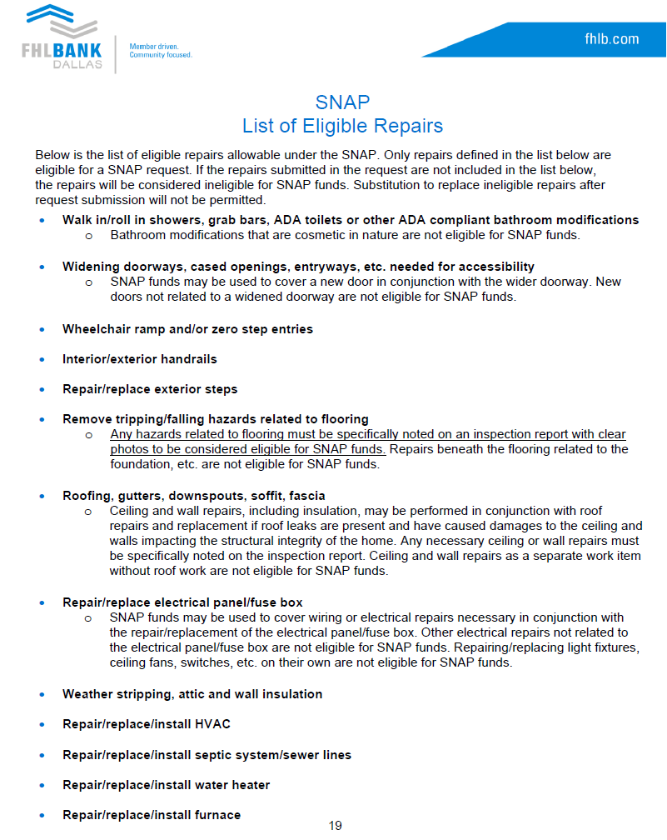
Eligible Repair List
SNAP funds can cover repairs specified in the funding manual
Review eligible repairs prior to submission
  Ineligible repairs will not be funded and delay disbursements
  Ineligible repairs cannot be swapped out after submission
SNAP funds can be used in conjunction with other sources of funds (outside of FHLB programs)
  If non-SNAP funds cover ineligible repairs, the cost of each repair must be itemized, the source of funds must be labeled on the Home Repair Estimate

Slide 27
For More Information
Questions?
Contact Us!
By Phone: 800.362.2944
By Email: fortifiedfund@fhlb.com
heirs@fhlb.com
ahp@fhlb.com
Additional information is available online at fhlb.com
Notes:
Please utilize the Community Investment department analysts.
We can see your application as soon as it is in the online portal.

